Slide 1
Present
Welcome to the modern classroom.

Slide 2
Today’s Classroom
Over 90% of teenagers own smartphones
75% feel the need to immediately respond to texts, messages, and notifications
Student engagement is negatively correlated with smartphone ownership
Off-task phone users perform up to 70% worse on classroom metrics
Teachers are frustrated and exhausted competing with smartphones for student attention
Phone policies from bans to “responsible use” are challenging to enforce, impractical, and unpopular with parents
Technology is an invaluable teaching tool in the modern classroom

Slide 3
Our Mission
“Change the education experience by empowering teachers to easily and affordably connect and engage with all students in the classroom via technology”

Slide 4
Our Solution
Prevent smartphone distractions before they occur
Engage students with innovative teaching applications using their personal devices
Improve academic honesty and prevent cheating
Equip students with the tools to develop healthy technology habits – for life
Eliminate the burden of monitoring and policing students’ personal devices
Empower teachers to gain the benefits of a modern, technology-enabled classroom
Give economically-disadvantaged districts the benefits of “one student, one device” without paying hundreds of dollars per student

Slide 5

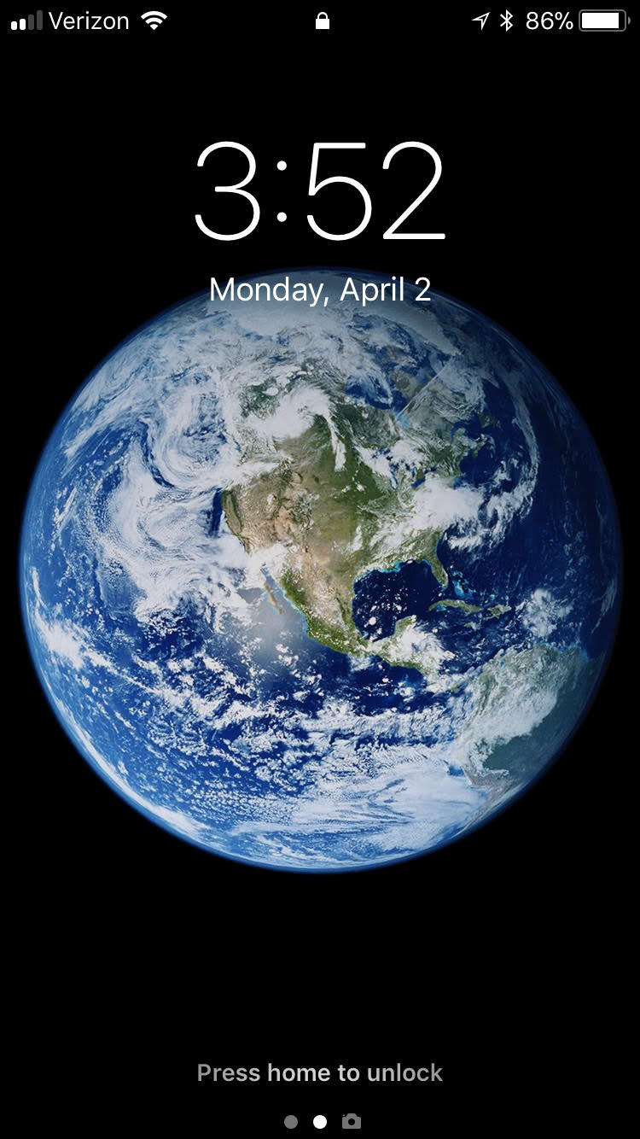

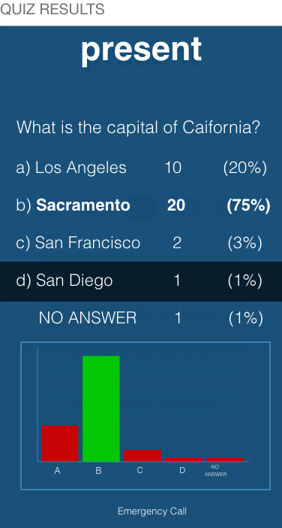
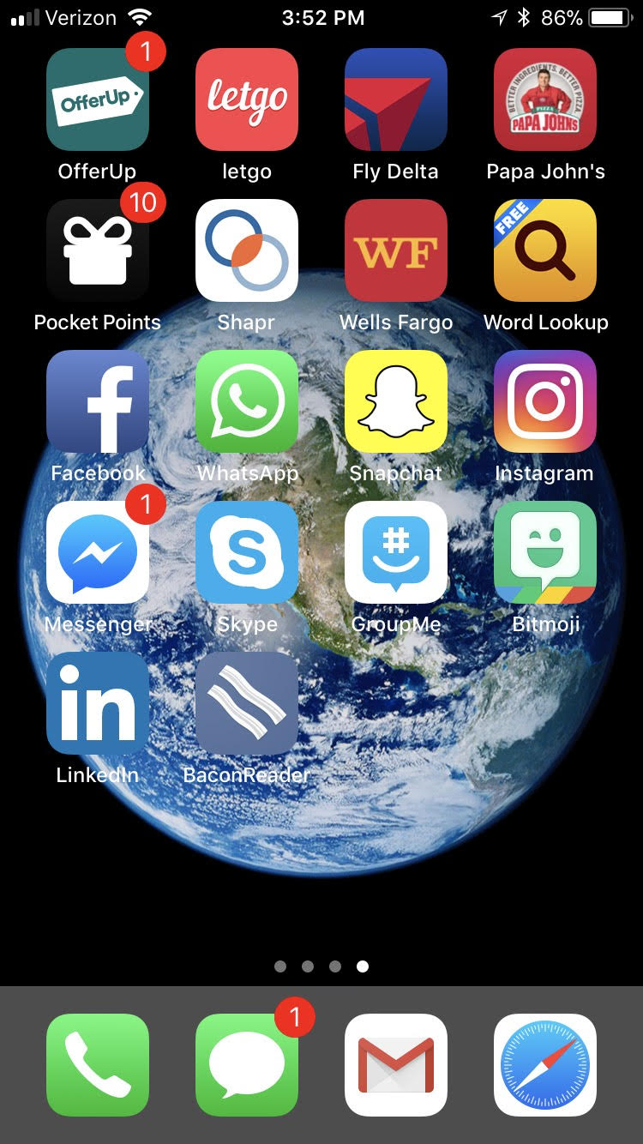
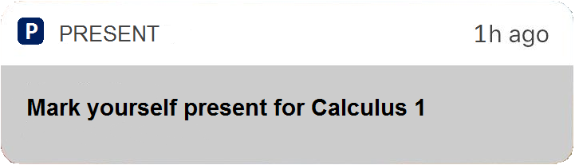
How It Works
1
At start of class, students are notified to mark themselves “Present”.
2
Student phones are locked. They cannot text, email, game or use other distracting apps.
3
Teachers can create, distribute, and view live-quizzes to engage students via devices.
4
At the end of class, student phones are automatically unlocked.

Slide 6
Market Size
5.2 Million
1.4 Million
150,000
Elementary through Post-Secondary Teachers (USA)
Total Available Market
Middle and High School Teachers
Total Serviceable Market
Early Adopters
Target Market Share

Slide 7
Business Model
Phase 1: We charge $5-$10 per teacher per month, depending on school size
Phase 2: We charge app partners 10% commission fee to integrate
Phase 3: We sell data analytics and insights to schools
Phase 1
(Teacher Revenue)
150,000
$63
$9.5M
Early Adopter Teachers
Target Market Share
Annual Revenue/Teacher
$7/mo for 9 month school year
Recurring Annual Revenue
For Early Adopter Teachers (10% of Serviceable Market)

Slide 8











Competition
Affordable
Present Differentiators
Present
Eliminates distractions from native iOS apps (messaging and safari)
Affordable for low-income districts
Works on student owned devices
Designed for teachers, not IT administrators
Provides classroom engagement tools
Lacks Key Features
Addresses Problem
FlipD
Expensive
No competitor offers a comprehensive classroom management solution for students’ personal phones

